Slide 1

Critical Thinking
Lecture 1 Part II: Introduction to decisions
Alessandro Demichelis
Department of Mathematics
AY 2024-25
School of Industrial and Information Engineering

Slide 2

Who am I?
From Philosophy to Cognitive Science
(Social) knowledge, behaviours, and decisions
Mostly on medical and pharmaceutical settings
IMT School for Advanced Studies Lucca

Slide 3

Who are you? Expectations?

Slide 4


Slide 5
Studying Decision Making

Slide 6
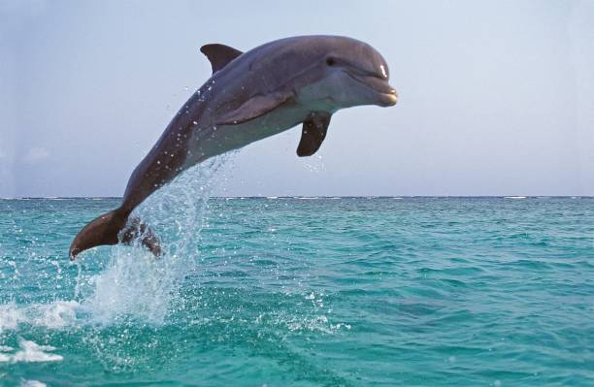
IT STARTED WITH PLAY

Slide 7

IT STARTED WITH PLAY

Slide 8

IT STARTED WITH PLAY

Slide 9
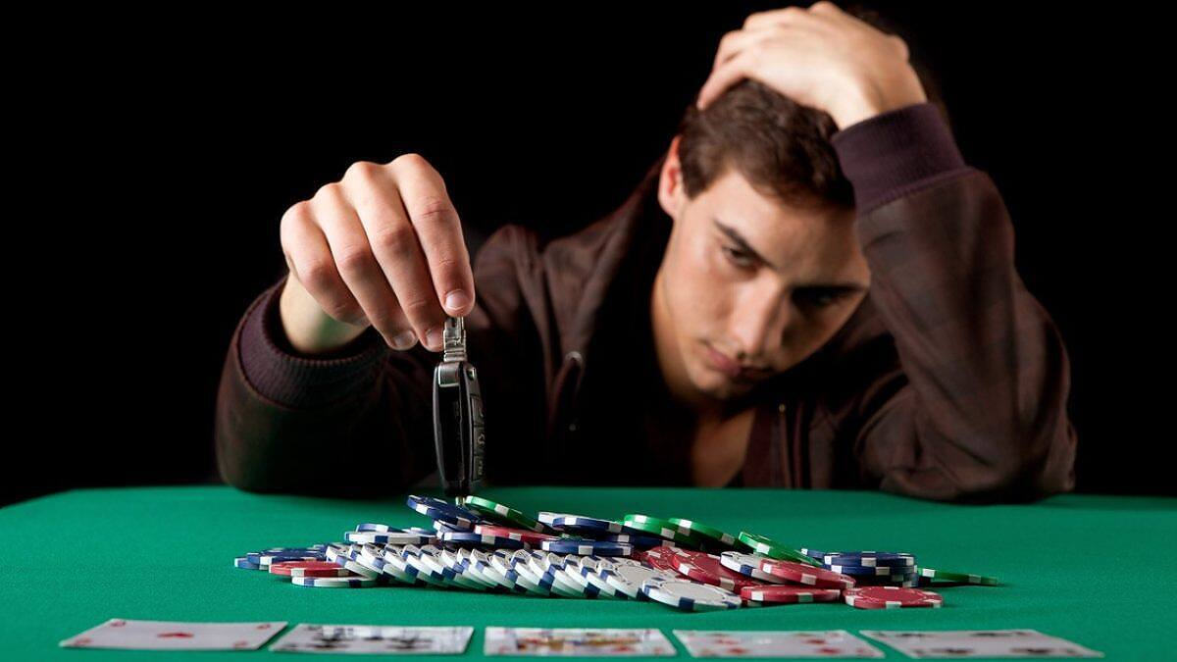
IT STARTED WITH PLAY

Slide 10
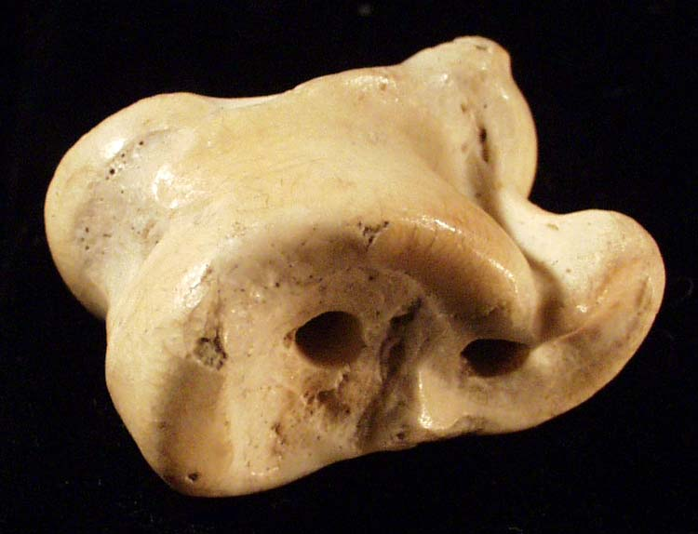
A little bone

Slide 11
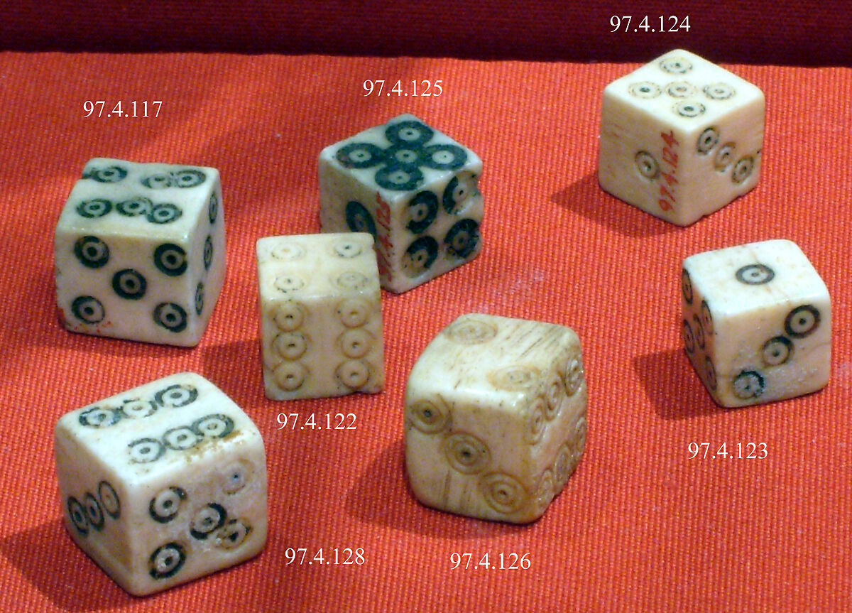
A little bone

Slide 12
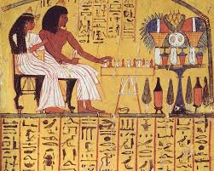
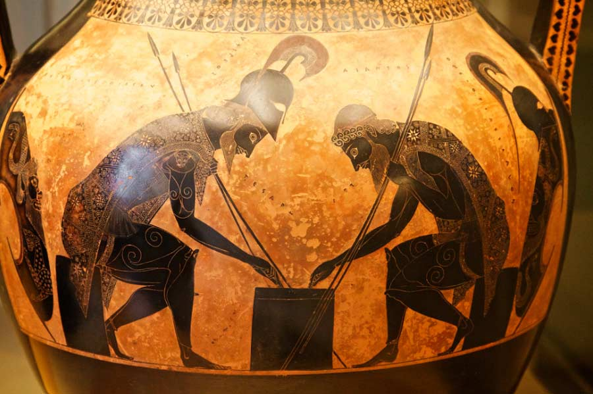
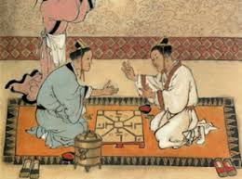
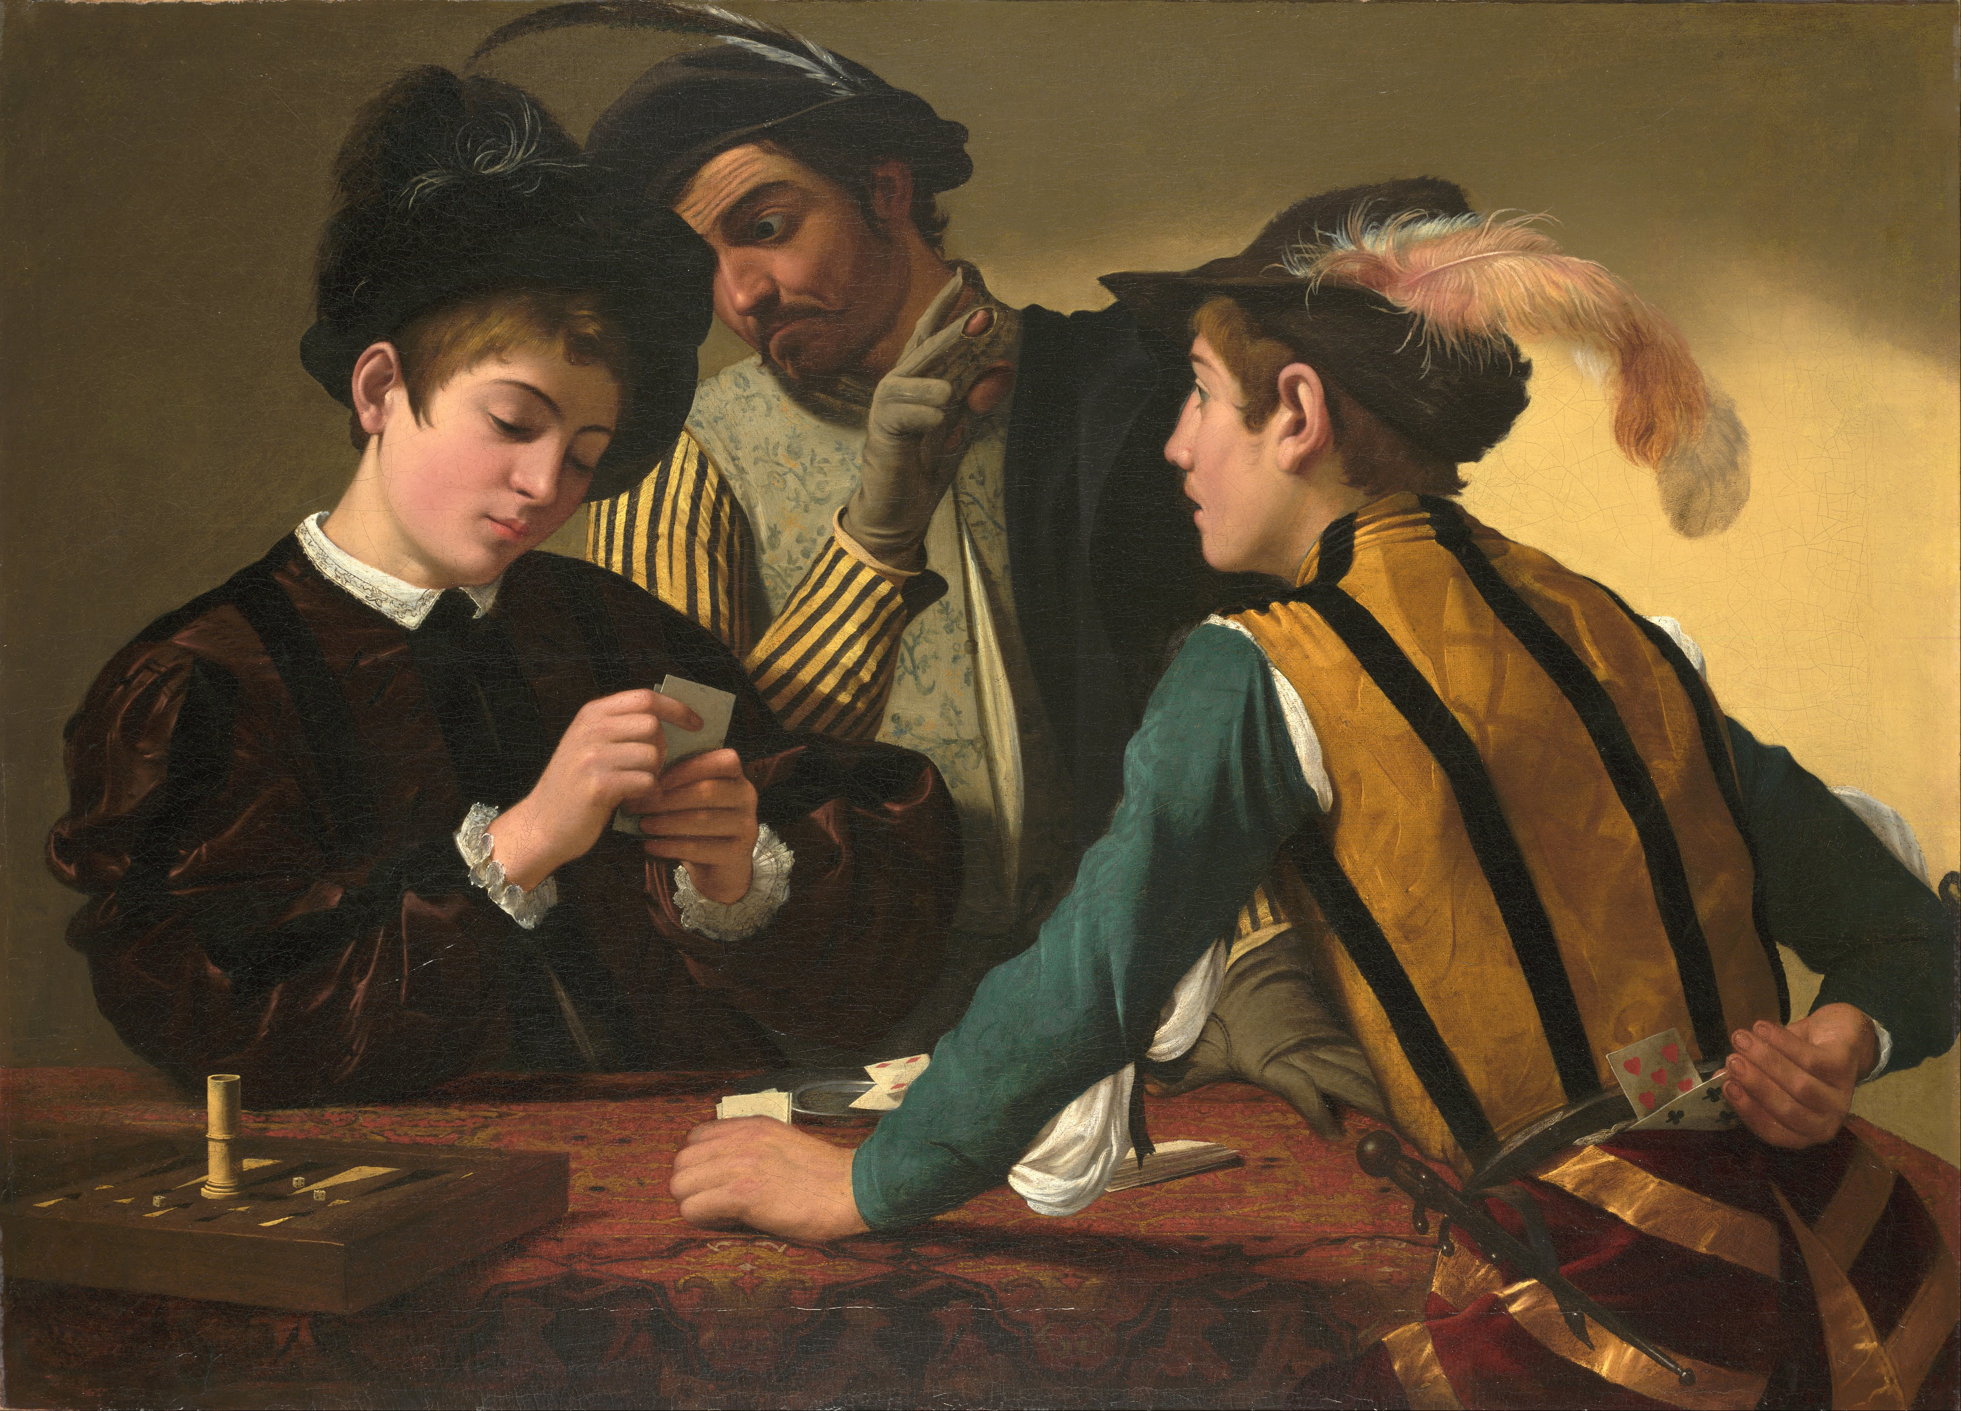

Slide 13
How to win?

Slide 14
How to win?
Identification of winning conditions (objective): what we want

Slide 15
How to win?
Identification of winning conditions (objective): what we want
Identification of best path (strategy): what we should do to get what we want

Slide 16
How to win?
Identification of winning conditions (objective): what we want
Identification of best path (strategy): what we should do to get what we want
Implementation of strategy: what we actually do

Slide 17
How to win?
Identification of winning conditions (objective): what we want
Identification of best path (strategy): what we should do to get what we want
Implementation of strategy: what we actually do
Identification of winning conditions (objective): what we want
Identification of best path (strategy): what we should do to get what we want
Implementation of strategy: what we actually do
NORMATIVE DECISION THEORY

Slide 18
How to win?
Identification of winning conditions (objective): what we want
Identification of best path (strategy): what we should do to get what we want
Implementation of strategy: what we actually do
DESCRIPTIVE DECISION THEORY

Slide 19
How to win?
Identification of winning conditions (objective): what we want
Identification of best path (strategy): what we should do to get what we want
Implementation of strategy: what we actually do
WHAT IS MORE IMPORTANT?

Slide 20
What is more important?

Slide 21
Normative and Descriptive
Theory vs. Practice

Slide 22
Normative and Descriptive
Theory vs. Practice
Theoretical vs. Empirical

Slide 23
Normative and Descriptive
Theory vs. Practice
Theoretical vs. Empirical
Norms as laws, norms as guidelines, norms as horizon

Slide 24
Normative and Descriptive
Theory vs. Practice
Theoretical vs. Empirical
Norms as laws, norms as guidelines, norms as horizon
What kind of laws?

Slide 25
Normative and Descriptive
Theory vs. Practice
Theoretical vs. Empirical
Norms as laws, norms as guidelines, norms as horizon
Rational ≠ Right

Slide 26
What is probability?

Slide 27
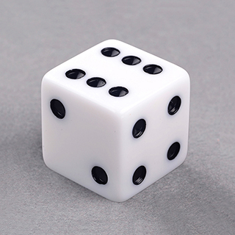

Slide 28
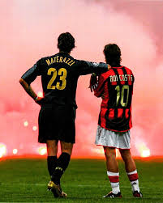

Slide 29
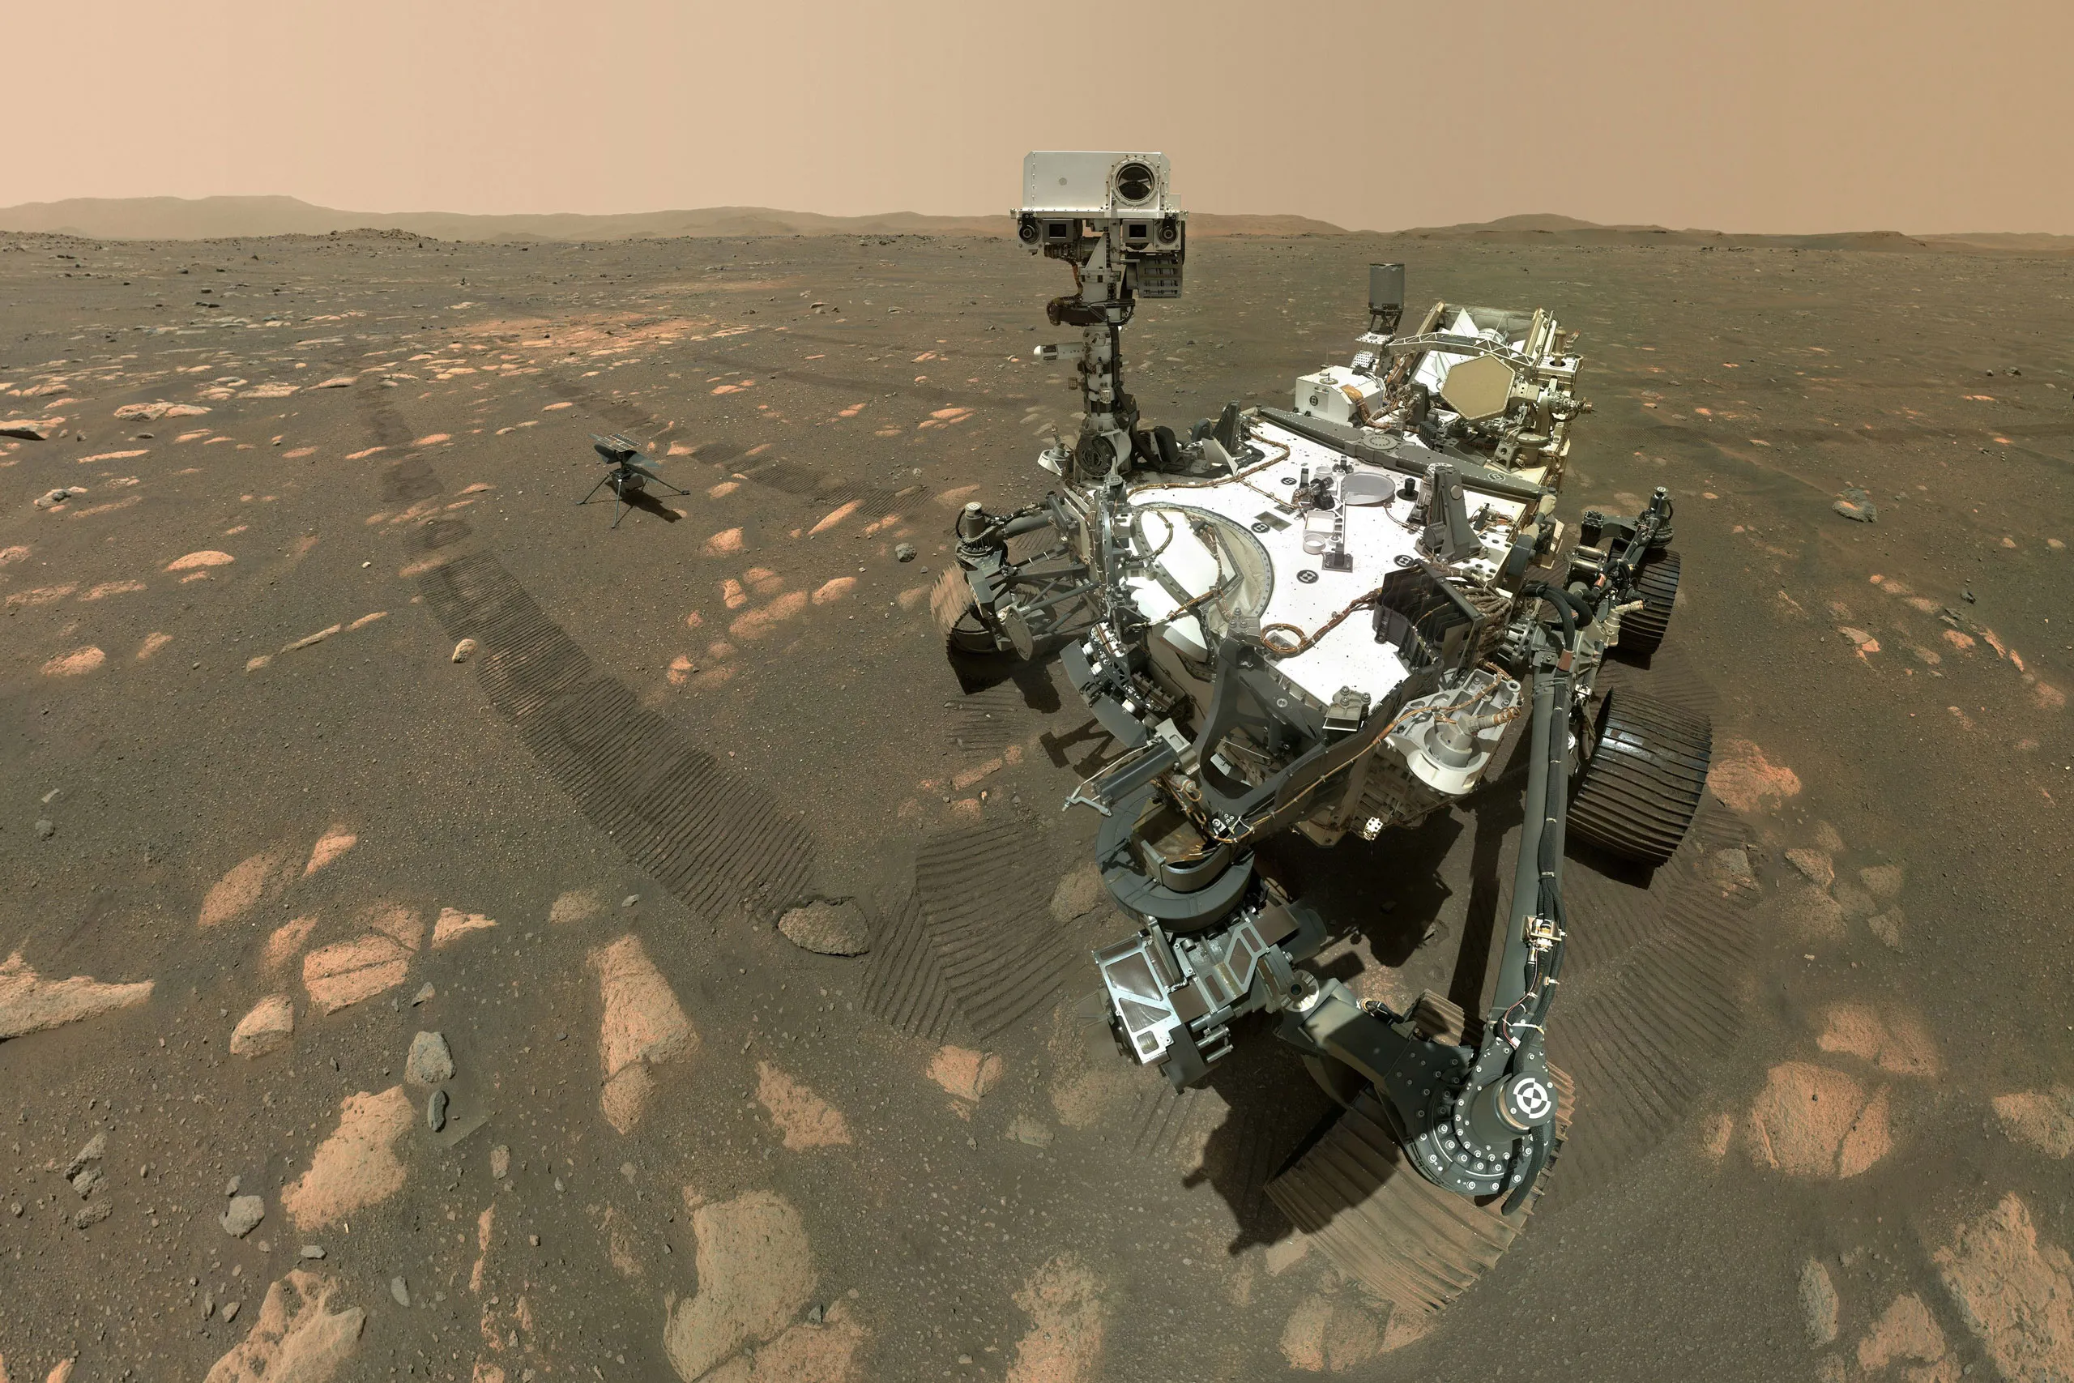

Slide 30
Interpretations of probability
Classical (N of favourable cases/ N of possible cases)

Slide 31
Interpretations of probability
Classical (N of favourable cases/ N of possible cases)
Frequency (N of positive instances / N of trials)

Slide 32
Interpretations of probability
Classical (N of favourable cases/ N of possible cases)
Frequency (N of positive instances / N of trials)
Propensity

Slide 33
Interpretations of probability
Classical (N of favourable cases/ N of possible cases)
Frequency (N of positive instances / N of trials)
Propensity
Epistemic (subjective)

Slide 34
Interpretations of probability
Classical (N of favourable cases/ N of possible cases)
Frequency (N of positive instances / N of trials)
Propensity
Epistemic (subjective)
Frequentist vs. Bayesian debate

Slide 35
Ignorance, Risk, Uncertainty

Slide 36
Stances on future
Ignorance: the future is unknown

Slide 37
Stances on future
Ignorance: the future is unknown
Uncertainty: the future is unknown and we cannot assign probabilities/ we can only assign subjective probabilities

Slide 38
Stances on future
Ignorance: the future is unknown
Uncertainty: the future is unknown and we cannot assign probabilities/ we can only assign subjective probabilities
Risk: the future is unknown but we can assign frequentist probabilities

Slide 40
Decision Making under Risk

Slide 41
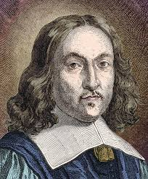
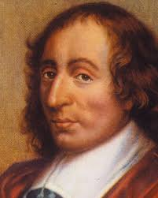
Fermat and Pascal: split the pot

Slide 42
Fermat and Pascal: split the pot
The value of future gain is directly proportional to the probability of getting it

Slide 43
Expected Value
A predicted value of a set of outcomes, calculated as the sum of all possible values each multiplied by the probability of its occurrence.

Slide 44
Expected Value: the lemonade kiosk
Sunny day: 400€
Cloudy day: 100€
Rainy day: 0€
Tomorrow: 50% sun, 30% Cloud, 20% Rain
Expected revenue=?

Slide 45
Expected Value: the lemonade kiosk
Sunny day: 400€
Cloudy day: 100€
Rainy day: 0€
Tomorrow: 50% sun, 30% Cloud, 20% Rain
EV= (0.5 x 400€) + (0.3 x 100€) + (0.2 x 0€) = 230€

Slide 46
Fermat and Pascal: split the pot
What if we don’t consider the game until its
end, but just how useful is for each player to win another round?

Slide 47
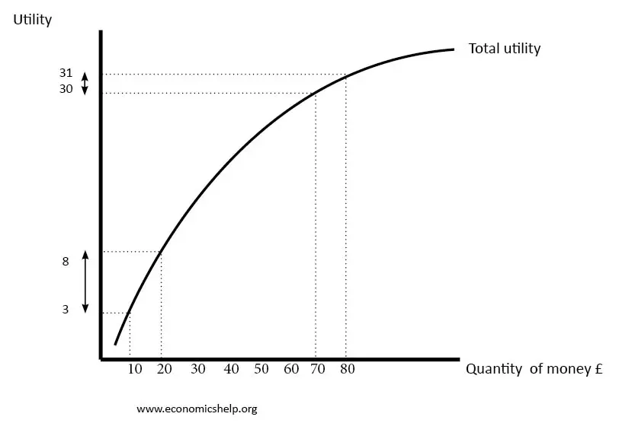
EU

Slide 48
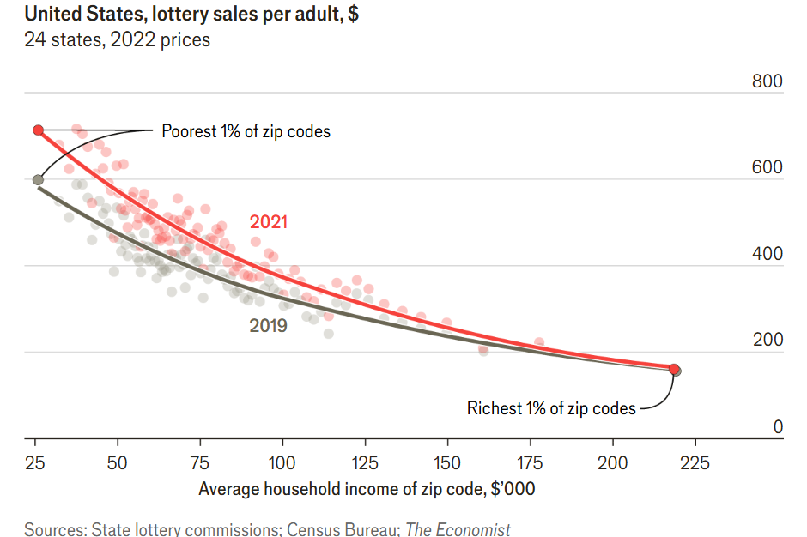
The economics of American lotteries, The Economist, 02/04/2024

Slide 50
Von Neumann - Morgenstern
The axioms of utility

Slide 51
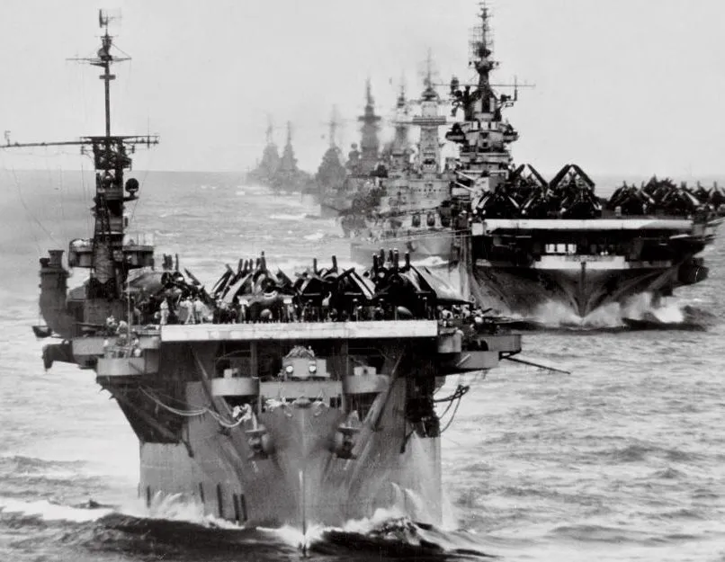
Von Neumann - Morgenstern

Slide 52
Expected utility hypothesis
A rational agent maximizes utility.

Slide 53
Von Neumann - Morgenstern
What do we need to maximise utility?

Slide 54
Axioms to maximize utility
Completeness: every possible outcome is ranked as more preferable, less preferable, or indifferent regarding the others. If L and M are two options, then preferences should be either L ≤ M or L ≥ M ;

Slide 55
Axioms to maximize utility
Transitivity: this ranking must respect the relative order of preference. If L ≥ M and M ≥ N, then L ≥ N ;

Slide 56
Axioms to maximize utility
Continuity: there are middle points in the ranking. Suppose L ≥ M, M ≥ N, and L ≥ N. Then, if we devise a lottery that gives you L with a probability p and N with a probability (1-p), there exists a value of p that makes the choice of playing the lottery indifferent to the choice of getting M with certainty ;

Slide 57
Axioms to maximize utility
Independence: the relative ranking of two outcomes is not affected by the presence of a third alternative. Suppose we rank L ≥ M; this ordering remains the same even when we introduce a third outcome N.

Slide 58


Why follow the axioms? Dutch Book
>

Slide 59

Why follow the axioms? Dutch Book
>

Slide 60
Why follow the axioms? Dutch Book
Transitivity:
>

Slide 61
Why follow the axioms? Dutch Book
>
>
>

Slide 62
Why follow the axioms? Dutch Book
>
>
>
S-3€
V-2€
C-1€
S

Slide 63
Why follow the axioms? Dutch Book
>
>
>
S-3€
V-2€
C-1€
S

Slide 64
St. Petersburg, Allais, Ellsberg

Slide 65
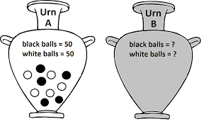

Slide 66
Rank the bets!
Bet X: get 100€ if white is drawn from urn A, 0€ otherwise
Bet Y: get 100€ if black is drawn from urn A, 0€ otherwise
Bet W: get 100€ if white is drawn from urn B, 0€ otherwise
Bet Z: get 100€ if black is drawn from urn B, 0€ otherwise

Slide 67


Slide 68
Ellsberg paradox
There is experimental evidence of preference to certainty; however, choice between X and Y is indifferent
Experimental evidence show that X is preferred to W and at the same time Y is preferred to Z
PARADOX! If X (Y) is ranked before Y (X), Z (W) must be ranked before Y (X).

Slide 69
Ellsberg paradox today
A clash between frequentist and epistemic interpretation of probability!

Slide 70
Decoy pricing (asimmetric dominance)

Slide 71
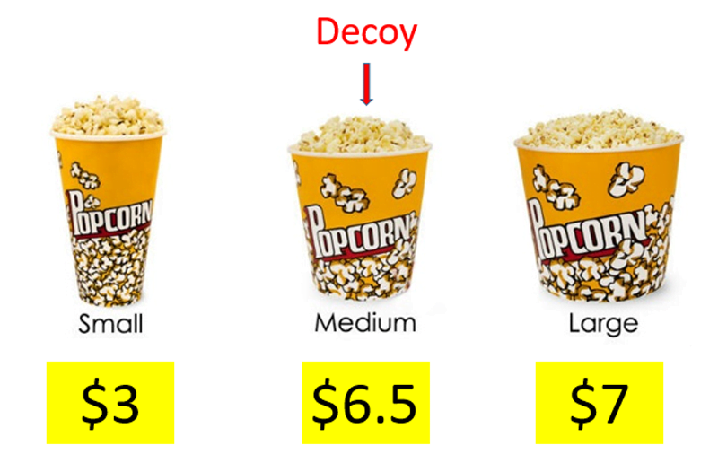

Slide 73


